Slide 1
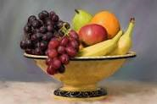
HEALTHY EARLY YEARS LONDON
Healthy Early Years London (HEYL) Silver Award for Health, Wellbeing and Education
Healthy Early Years London Silver Award Case Study/Learning Journey Template
Name of setting /childminder | Northcote House | Borough | Wandsworth
HEYL Silver Award health, wellbeing and education priority: (for settings and childminders) | Healthy Eating, including farm to fork process.

Slide 2
Information about Northcote House
We are a private day nursery situated near Clapham Junction Station.
Our Vision is:
To enable all children to learn through a diverse range of real life experiences and resources, in the setting and when exploring the local community, alongside the parents and carers as the first educators of their children.
Whilst empowering the staff team to develop their knowledge, and understanding to provide consistent outstanding quality of education.
This will then provide the children with independence, enriching opportunities and the recall of experiences, and this then ensures the children are ready for the next stage of learning.

Slide 3
Starting points; the needs we identified
As we completed the HEYL audit we realised that the children need a greater understanding of where the food that is cooked and served here comes from. We also spoke about portion control and what are healthy and unhealthy foods.
We also looked at the statistics the UK has one of the highest rates of childhood obesity in Europe. In 2018, around one in 10 children aged four to five were classified as obese, and around one in five children aged 10 to 11 were.
Childhood obesity and excess weight are significant health issues for children and their families. There can be serious implications for a child’s physical and mental health, which can continue into adulthood. The number of children with an unhealthy and potentially dangerous weight is a national public health concern.
From this statistics we wanted to be advocates for healthy eating and change the mind set of parents and children in making better choices.

Slide 4
Action plan; The difference we wanted to make and how we did it.
To actively promote healthy eating we decided to:
Implement a cooking station in our pre school room where the children are able to do healthy cooking each week with their key person, this helps discussion around the ingredients and where they come from. The chef would do weekly healthy cooking with the children, he would go and take the children to the fishmongers and then they would all discuss and cut the fish together.
We implemented Hydro veg so children could watch and document the growth of the herbs and plants and would help the chef pick them for ingredients, this then helps understanding of planting and life cycles. We spoke about eating 5 fruit or vegetables each day, which led to discussions about our favourite fruit and vegetables, this then linked to the story Handas surprise.
We also spoke about healthy and unhealthy foods, where we set an activity for children to look at and discuss if they thought the foods were healthy or unhealthy. We decided to send a recipe home of Spaghetti Bolognaise that the children could make at home.

Slide 5
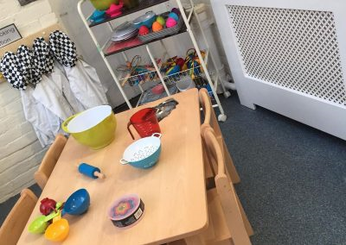
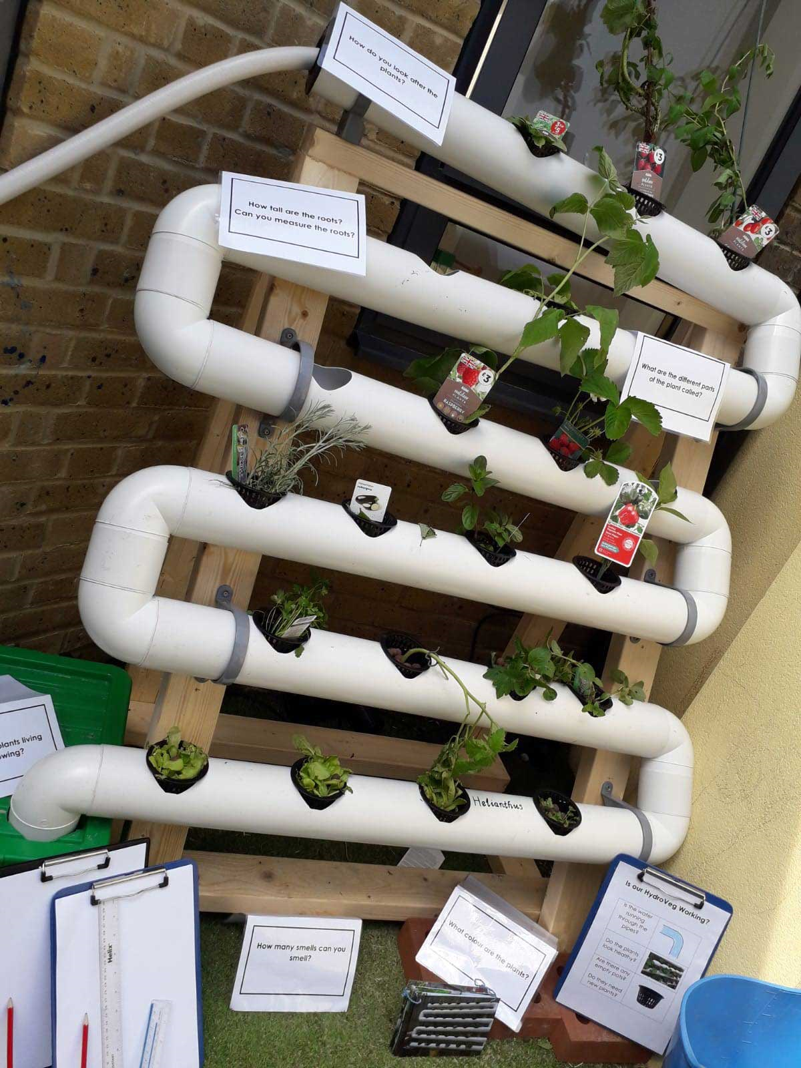
To achieve this we:
Put a healthy recipe of the week on our website for the parents to try at home, this was spaghetti bolognaise where the spaghetti was replaced with wholemeal spaghetti and they added in carrot and courgette to make it healthy and contribute to one of their 5 a day.
Recipe below:
1 tbsp sunflower oil
1 small onion, chopped
½ celery stalk, chopped
1 medium carrot, grated
½ Courgette sliced in half
1 clove garlic, crushed
125g lean minced beef
200g tinned tomatoes
1 tsp tomato puree
A few drops Worcestershire sauce
¼ tsp fresh thyme leaves
200 ml unsalted or weak beef stock
75g Wholemeal spaghetti
Method
Heat the oil in a saucepan . Add the onion, celery , carrot and garlic and sauté for 5 minutes.
Add the minced meat and saute until browned, stirring occasionally.
Stir in the tomatoes , tomato puree, Worcestershire sauce , thyme and beef stock. Bring up to the boil then reduce the heat and cover and simmer for 15 minutes.
Meanwhile, cook the pasta . Blend the sauce if you wish or leave a little chunky and mix with the spaghetti
When we did cooking with the children we also sent home the recipe, through this process there was lots of discussion around where the food came from, one of the specific questions being did it grow overground or underground. This is a great way to expose different foods to children which helps to reduce picky eating.
We completed our food for life Silver award with Creed our food supplier, which talks about traceability and sustainability for our food.

Slide 6
Impact: The difference we made
Children were coming into nursery telling us what they had made at home, and were beginning to talk about the different food groups.
The children and parents made better choices at home and in the supermarket, but swapping unhealthy foods for more healthier foods, a parent commented that a child chose Radishes over sweets.
The children had input into the Autumn menu by telling the chef the foods they liked and disliked, they spoke about Carrot and Courgetti and some children said they have it curly at home, one of the children also asked about adding radishes to the menu.
The parents have also commented that at home and when going out to dinner, the children are keen to try new foods.

Slide 7
Our next steps
We have been reflecting on further ways to develop our practice as Healthy Early years setting and we are going to continuously promote healthy eating by putting a recipe on our website each month, for parents to cook at home with their children.
We have maintained and promoted healthy eating with the children but also educated the parents, on better choices and healthy food swops.
We will carry out a monthly cooking session with parents, where they can come into the nursery and cook with the Chef on a recipe that is on the menu.
We would like to next focus on the importance of oral hygiene and the benefits of exercise as this also has a strong link with healthy eating.

