Slide 1
Centre for London &
Greater London Authority
Annual Partnership Proposal 2023-24

Slide 2
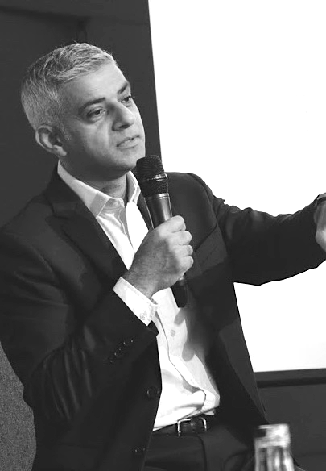
“I see Centre for London
as the city’s brain trust, constantly putting out high-quality, thoughtful
and timely work – something that will be more important than ever as we look to solve the challenges ahead.”
  Sadiq Khan
  Mayor of London

Slide 3
We hugely value our longstanding partnership with the Greater London Authority (GLA), which helps us to tackle London’s biggest challenges and bringing together London’s key decisionmakers.
Turning our current relationship into a planned annual partnership would be beneficial to us as it provides greater certainty. We also hope and expect it could work for you, helping you to better coordinate work and ensure maximum value.
We have annual partnerships with Transport for London; and we have just agreed a package for the year with Primera (which includes funding for several specific initiatives) and with the (currently) 16 organisations that are part of our Supporters’ Network.
This proposal outlines ways in which the GLA could engage in Centre for London’s work over the next 12 months, including:
joining our Supporters’ Network
sponsorship of the London Conference
engagement in our programme of research and events.
As part of any partnership, we would seek to informally involve the GLA in all our work. This proposal is intended for discussion, and we are happy to refine it further.

Slide 4
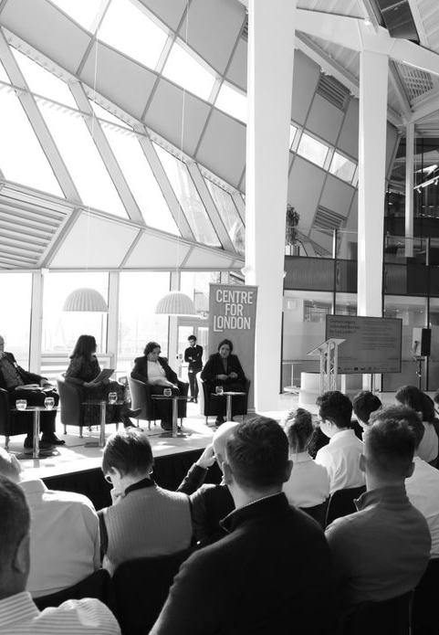
Our partnership so far
Centre for London and the GLA have worked together for many years tackling some of the biggest issues facing the capital.
While we don’t and won’t always agree with the Mayor, our role is as a critical friend to the GLA – and all other political decision makers in the city – by producing work designed to be helpful to the running of the city.
Some recent ways we have worked together include:
Sponsorship of the London Conference every year since 2016
Support for Centre for London’s major strategic projects including London Futures and Levelling Up
Partnerships tackling policy issues including looking at London’s town centres, food skills, self-employment, lighting London
Commissioned work including the Mayor’s Public London Charter
Most recently, hosting the East x Southeast Conference in March 2022 in the new City Hall

Slide 5
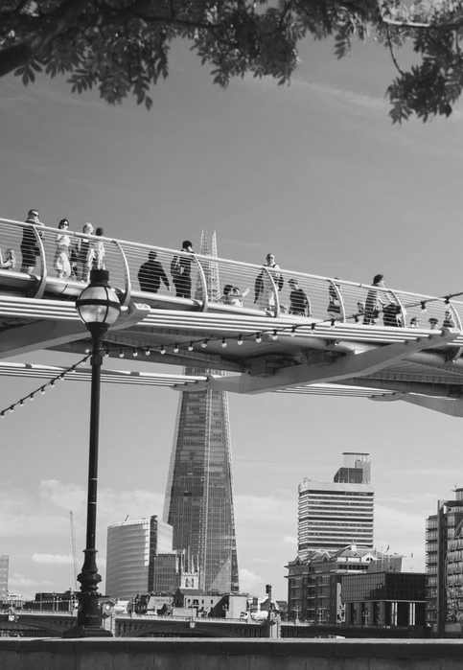
How we see London’s unique challenges
At its best, London is a prosperous and creative world city, with a global reputation for business, openness and diversity.
But this success masks another story: of chronic problems and inequalities, with millions of Londoners feeling unsafe, suffering poor health and facing everyday struggles.
Now, London faces a new era of disruption and uncertainty: a shifting role in the global economy, the fallout from Covid, accelerating environmental crises, and rapid political, technological and social change.

Slide 6
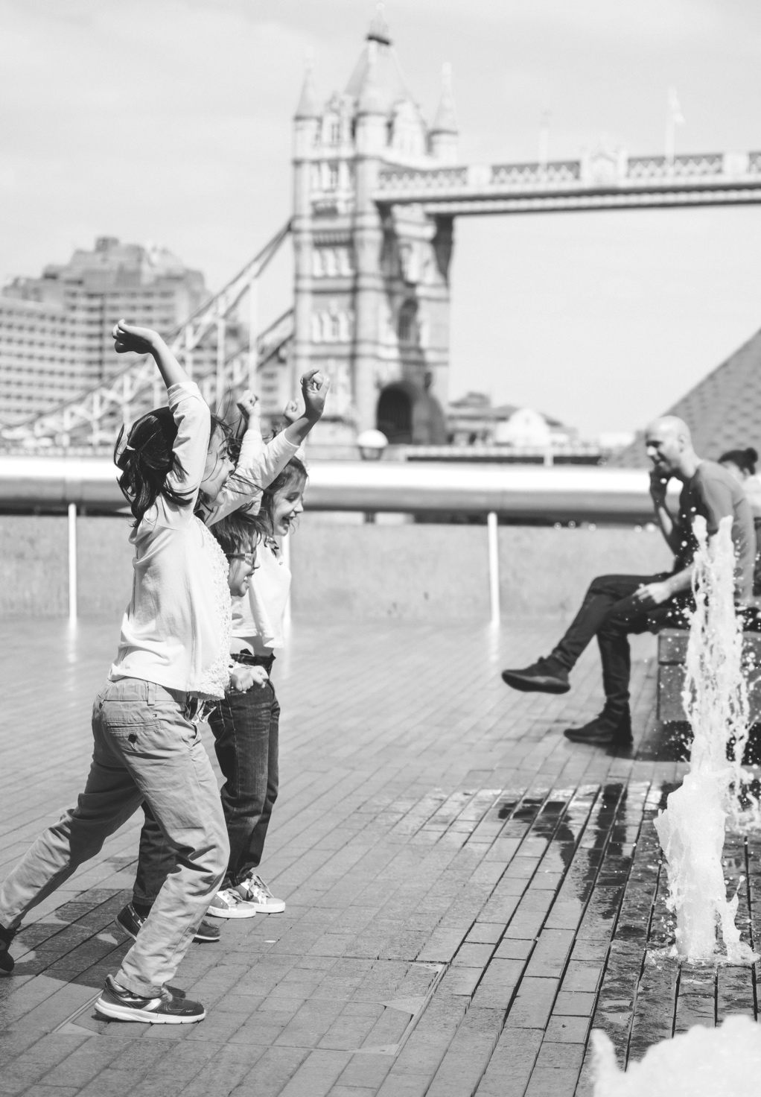
Our vision: a thriving, sustainable global city
Although London’s future is uncertain, it can be shaped.
Together, we can create a thriving, sustainable global city, run in the long-term interests of its people, and the country as a whole.
Our vision is for London to flourish as a safe, open, well-connected and dynamic city, leading the way to a sustainable future.
We want every Londoner to have enough money for essentials; a secure, decent home; and access to spaces and opportunities that enrich their lives, lead to improved health and allow them to fulfil their potential.
If we don’t act now, London risks faltering as a successful global city, and further failing Londoners most in need of support.
Developing the right solutions to London’s challenges requires innovative, long-term thinking that adapts to the ever-changing policy landscape and realities of life in London.

Slide 7
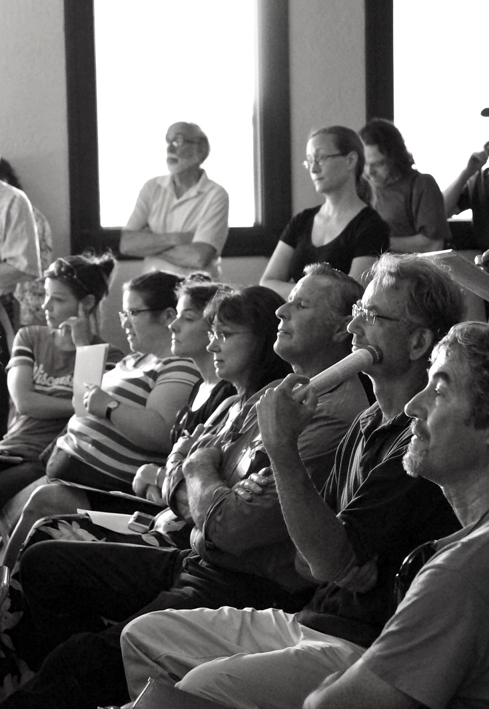
What we do
Research and evidence. We conduct robust, unbiased research and analysis, and collaborate with Londoners and stakeholders across all sectors, to generate new ideas and recommendations.
Convening and collaborating. We bring together citizens, experts and decision makers from diverse standpoints to discuss complex issues in a safe space, devise solutions and work out how to implement them.
Awareness raising and advocacy. We are an authoritative policy voice on London and promote our research and ideas to those with the power to act on them – from London’s leaders to the grassroots – through briefings, publications, social media, press and events.

Slide 8

Help us make London better for everyone
Because we are independent, we don’t rely on the automatic backing of one set of interests or another. We are not a membership organisation, and do not have statutory funding, property or an endowment.
We depend on the support of public-spirited organisations who love London and want to help shape its future.
A partnership with the GLA not only gives us much-needed support, but is also an invaluable endorsement of our work and its value to the city.
The contribution you make through partnership will contribute to our core funding, which enables us to think strategically about London’s challenges. It gives us the space to react as quickly as possible to policy developments and commit to unfunded research, all to improve the lives of Londoners now and in the future.

Slide 9
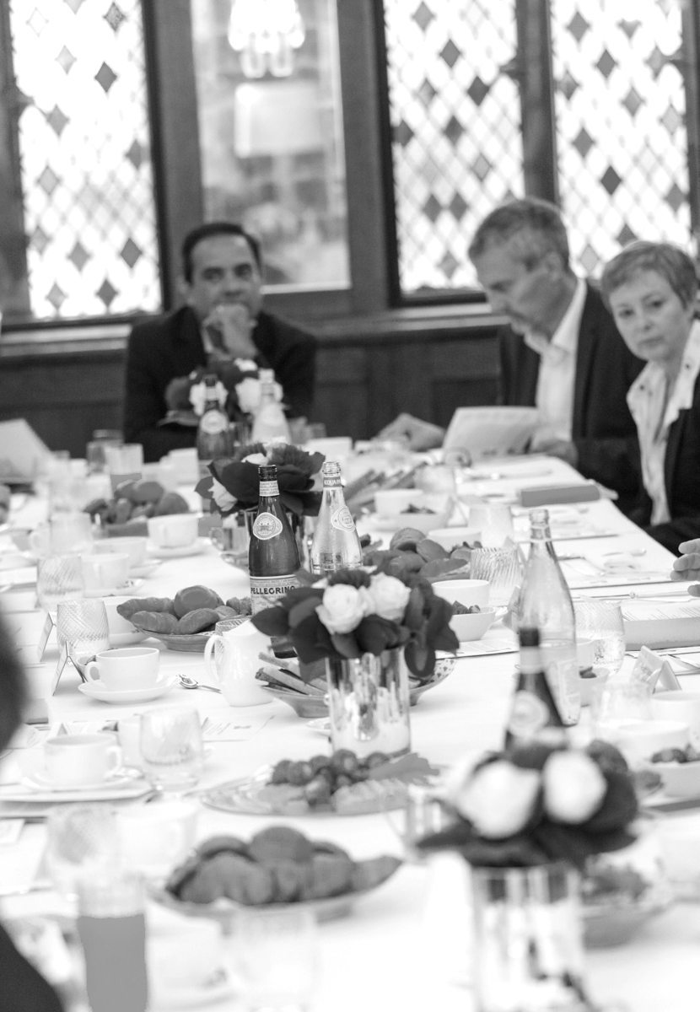
Supporters’ Network private roundtables
Our regular private roundtables with major London decision makers are a key Supporters’ Network benefit.
We run around eight roundtables a year. In the past we have invited many senior GLA figures to speak at these events, including Debbie Weekes-Bernard, Rajesh Agrawal, and Shirley Rodrigues.
As part of any partnership, we would not only wish to continue this but also coordinate with you to invite senior officials from across the GLA to attend (and on occasions, speak at) these events, as well as organise bespoke presentations and briefings for GLA staff.

Slide 10
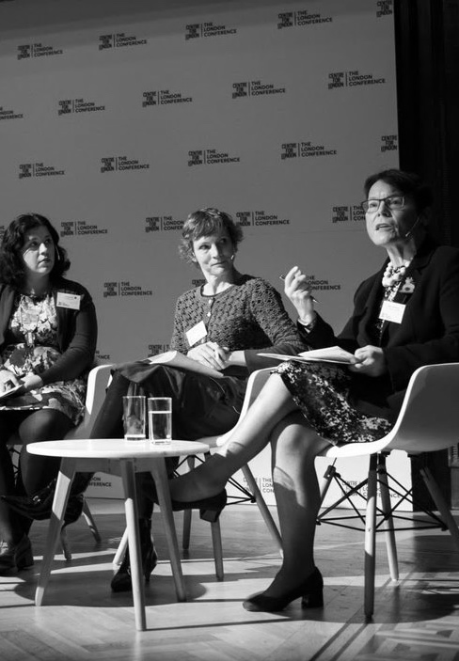
The London Conference 2022
The London Conference has established itself as the pre-eminent annual event for London’s leaders to come together to discuss and debate the capital’s future. It has been kindly supported by the GLA since 2016.
The conference is free to attend for delegates, but is invite-only. This means we bring together lively, high-level and diverse gatherings of leaders and thinkers each year.
We hugely appreciate our longstanding partnership over the conference and hope it can continue to grow, with a Mayoral keynote speech at the conference, GLA speakers on panels, and GLA branding and presence in force at the event itself.
It is hoped that this year’s conference will return to being fully in-person. It will be held on 1 November at Senate House, University of London.

Slide 11
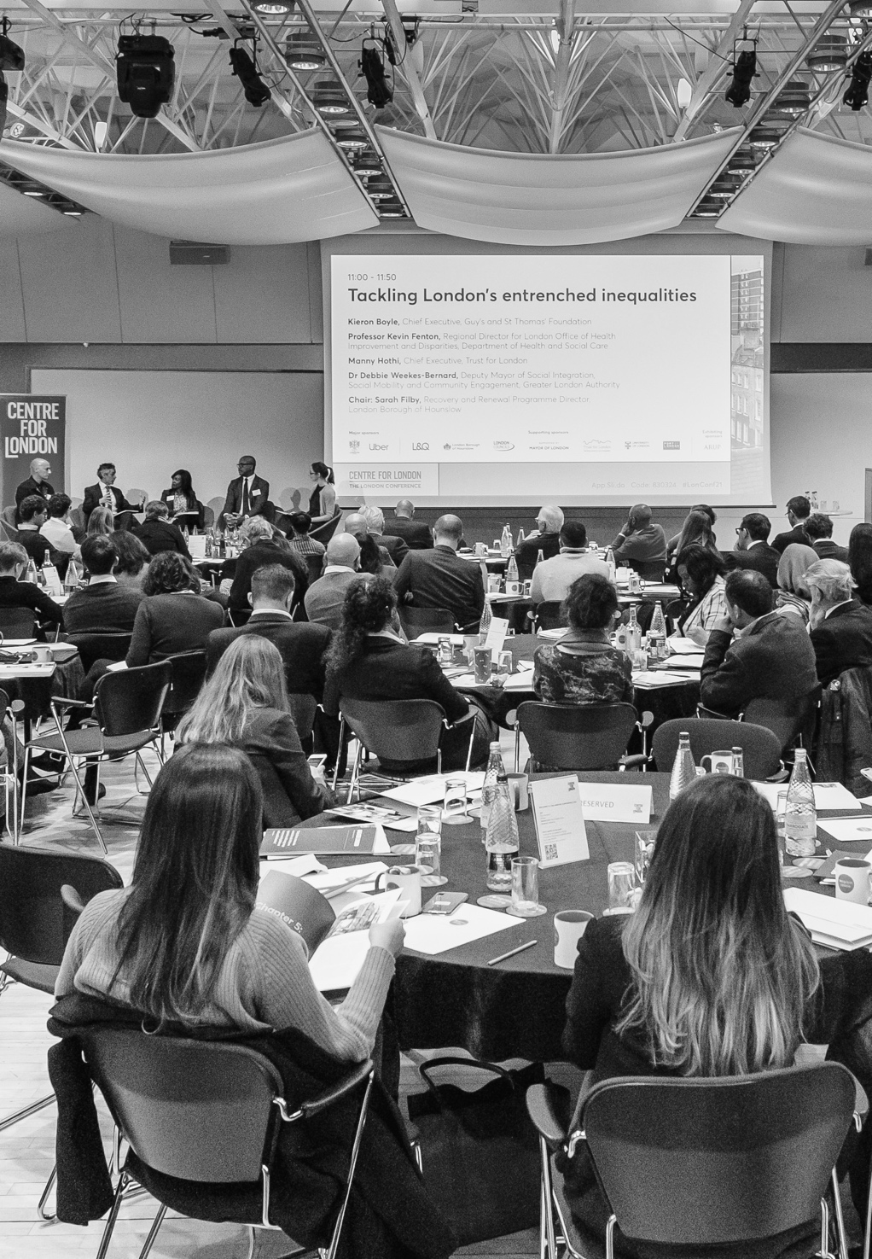
About this year’s conference
Venue: Senate House, University of London, Malet Street, WC1E 7HU
Date: 1 November 2022
This year, we are planning a return to a full-size in-person event, with 400 to 500 guests, for the first time since 2019.
We will also stream the conference live online – last year’s conference attracted 1,000-plus views and counting.
Topics will be chosen by Centre for London with feedback from conference funders and other experts as part of the conference advisory group.

Slide 12
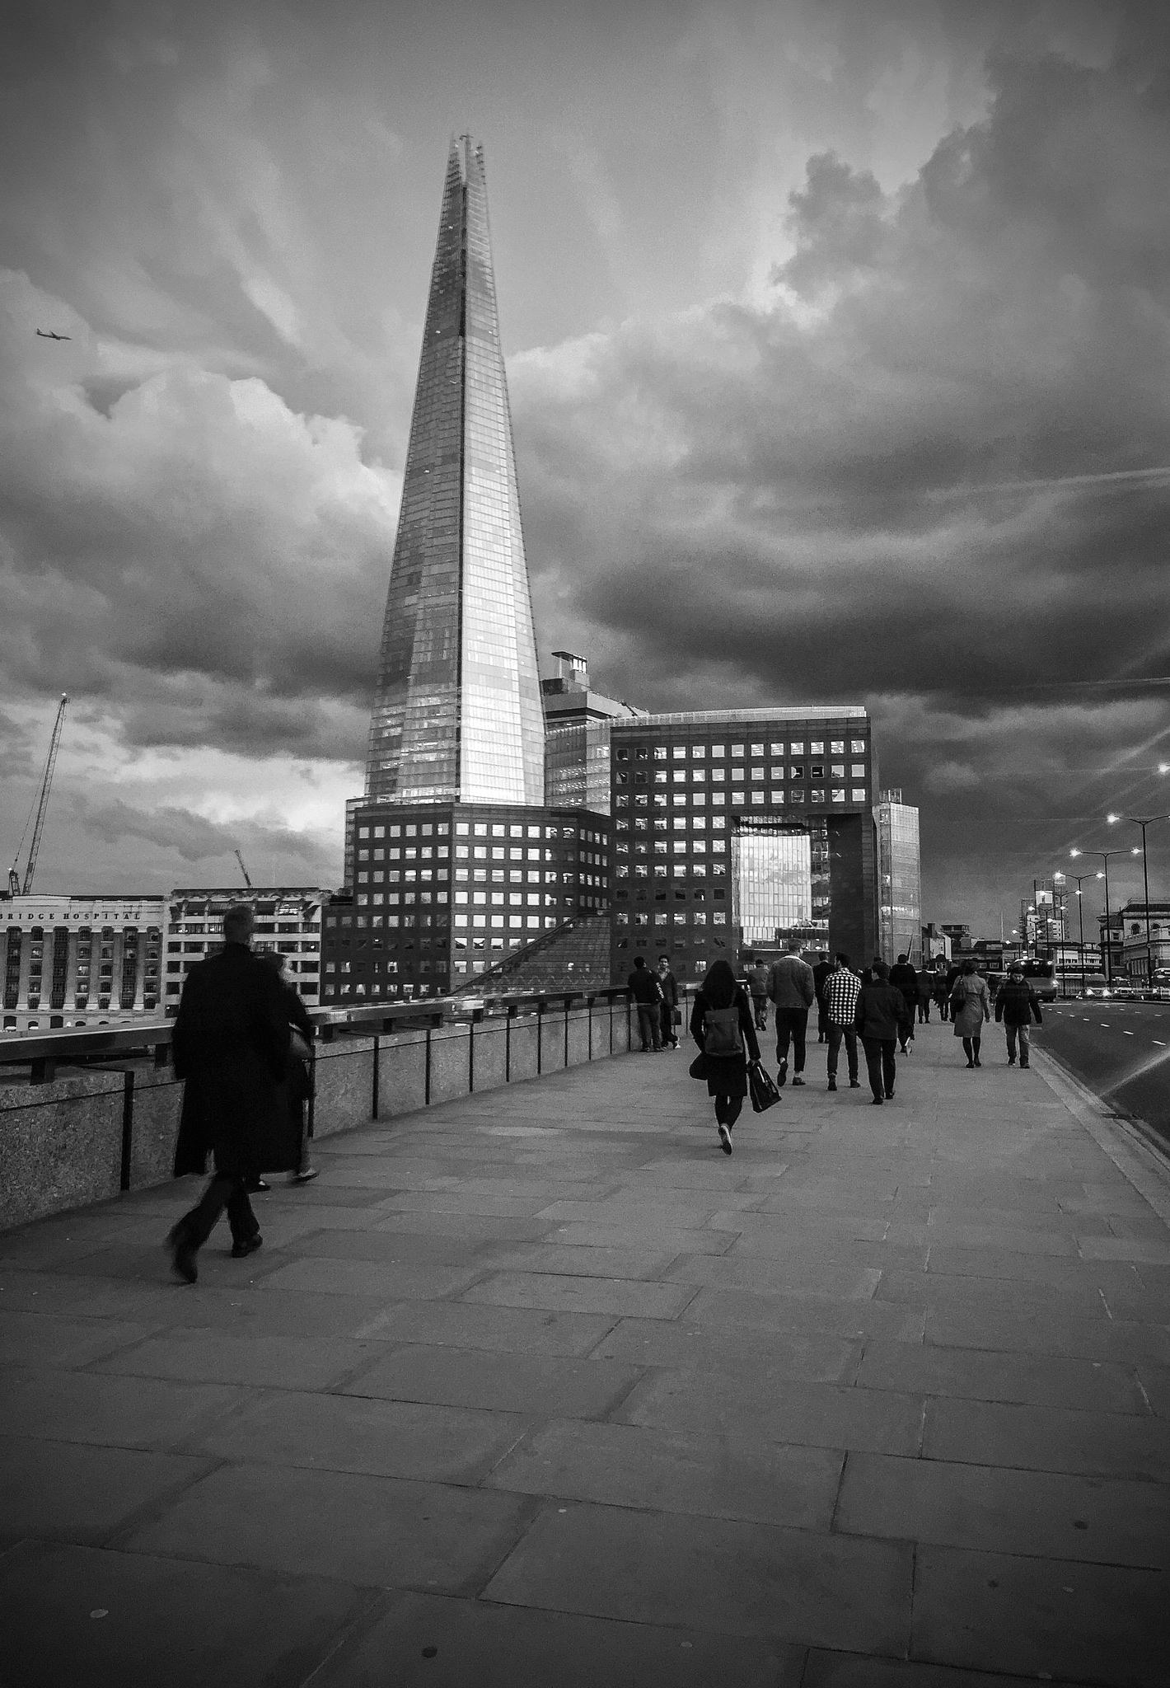
Other upcoming work
  We believe that a great deal of our work over the next 12 months will be relevant to your team. We’ll be looking at:
  How London should talk to the rest of the country about levelling up, and how we should try to shape the levelling up agenda
  Charting a course for a ‘clean, green, and lean’ transport system for London that responds to post-pandemic realities, including a focus on freight and logistics as well as passengers
  The future of placemaking in the capital, and the changing role and possible future of London’s West End
  Increasing the benefits to London for its role as a global hub for impact investment
  Improving standards in London’s private rental sector
  We can offer the GLA full sponsorship of specific projects as well as informal participation in each.

Slide 13

Our partnership
As well as specific credited support for our Supporters’ Network and the London Conference, we want to engage the GLA informally in all this work. The partnership has the following purposes:
Coordinate
Keep in regular contact, sharing policy priorities, our latest research findings, and our latest polling and data intelligence on London.
Platform
Give the GLA opportunities to share your work and priorities, to inform our work and our network of other partners and organisations across the public, private and third sectors.
Inform
Help your thinking (and ours) and engage your team with the most important issues facing the capital.

Slide 14
Annual partnership options
These options are for discussion, and we are happy to refine further.
We are assuming a partnership running from month of agreement, for 12 months, with a discussion to renew each 12 months (initially running up to Q2 2024 – the scheduled date for the next Mayoral election).
We can offer significant discounts when organisations combine pledges to support work throughout the year.
We suggest quarterly payments by default; by we are flexible on this.
Option A
(20% discount)*
£36,800+VAT p.a.
Option B
(£15% discount)*
£26,350+VAT p.a.
Option C
(10% discount)*
£14,400+VAT p.a.
Supporting Sponsor of the London Conference
Premium member of Supporters’ Network
Supporting Sponsor of two Centre for London research projects or events each year, to be discussed and agreed
*Cost without discount would be £46,000+VAT
Supporting Sponsor of the London Conference
Standard member of Supporters’ Network
Supporting Sponsor of one Centre for London research project or event each year, to be discussed and agreed
*Cost without discount would be £31,000+VAT
Supporting Sponsor of the London Conference
Standard member of Supporters’ Network
*Cost without discount would be £16,000+VAT

Slide 15
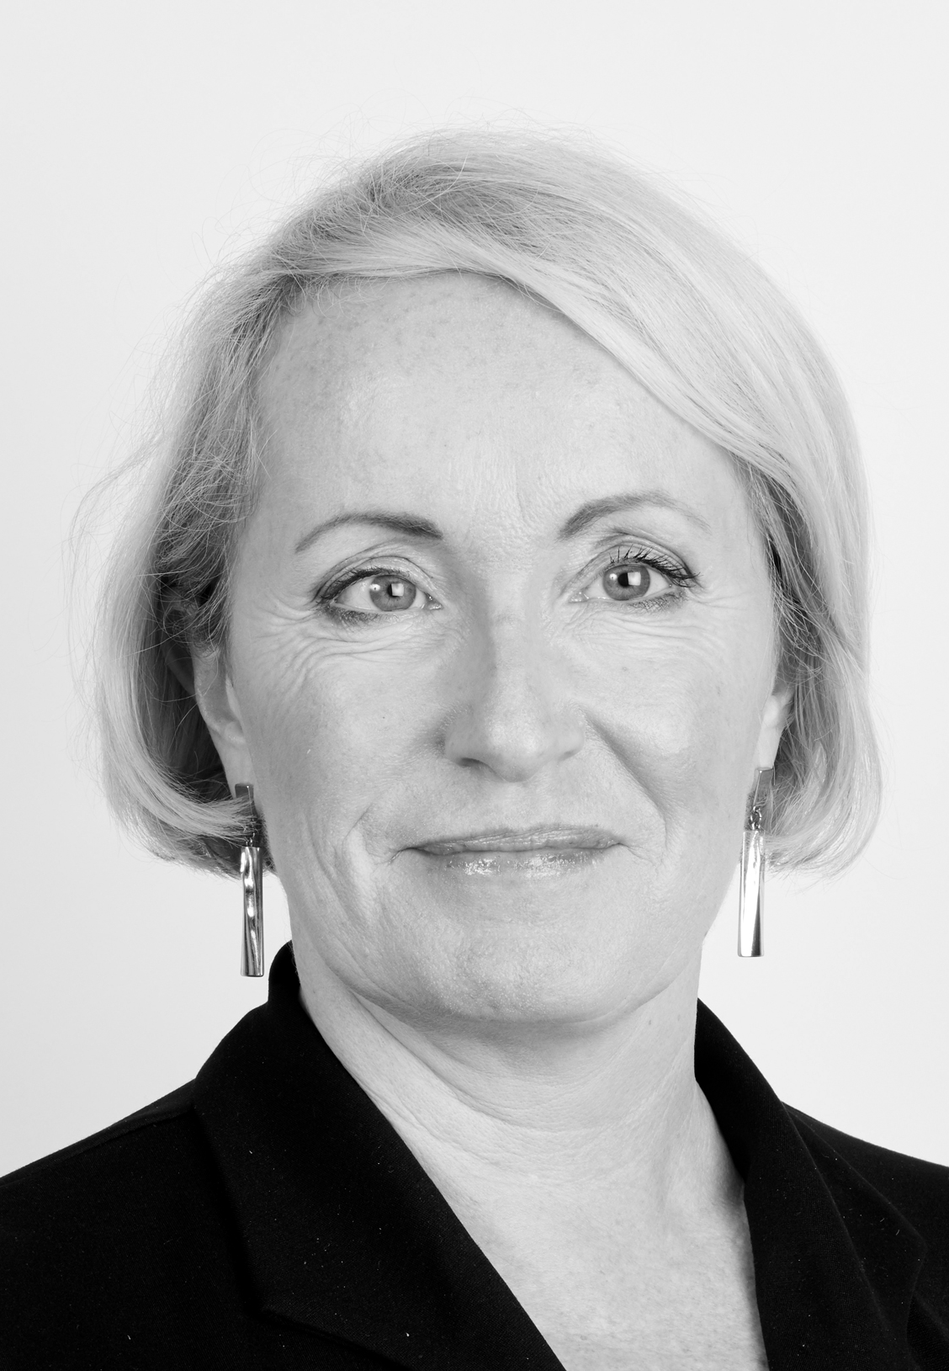
“ If you – like me – believe in a thriving, sustainable, global London, run in the long-term interests of its people and the UK as a whole, there is no better organisation to support than Centre for London. ”
  Fiona Fletcher-Smith, Centre for London Chair of Trustees and Chief Executive Officer, L&Q

Slide 16
Rob Whitehead, Director of Strategic Development
  rob.whitehead@centreforlondon.org

